Slide 1
IBM Bluemix Capabilities
IBM Cloud Ecosystem Development

Slide 2

Capability
- Cloud Foundry
- Contianers
- VMs
IBM Bluemix
Notes:
IBM Bluemix offers 3 type of deployment models for you to build your applications – Cloud Foundry, Docker based Containers and Openstack Virtual Machines.

Slide 3
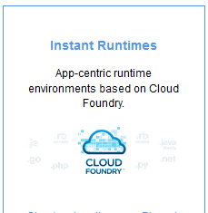
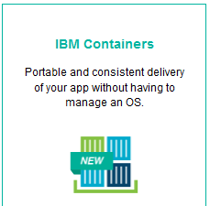
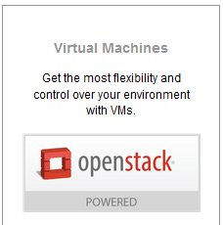

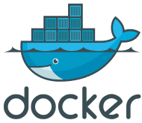
Bluemix offers different deployment models to run your code
Cloud Foundry
application
Docker based Container
Virtual Machine
expanding
Notes:
IBM Bluemix offers 3 deployment models for you to build yours applications in your preferred way. That includes
Instant runtimes app-centric runtime environments based on Cloud Foundry.
Extend Docker Containers – Portable and consistent delivery of your app without having to manage an on OS
Openstack Virtual Machines get the most flexibility and control over your environment with VMs.
You can use common ID & permissions for service binding and consumption then hook into common routing layer.
It offers options of flexibility and level of abstraction to meet your application requirements.

Slide 4
Bluemix offers different fit-for-purpose compute models for running your code
 | CF-managed Apps | Containers | VMs
Code Package | App source code, app package. Docker file/image (future/Diego) | Docker file / image | Binary package
Protocol for accessing apps | http(s), web sockets | any | any
Auto-recovery | Built-in, based on process health (today), flexible health detection (future/Diego) | Available, based on container health (up/down status, ping, HTTP ping) | Available (need further details)
OS patching | Done by IBM | Done by IBM | Done by user
Ability to store local process state | Stateless app (state persisted in services) | File system can be attached, state may be persisted in services | Filesystem persistent
Capacity | Memory flexible, CPU proportional to mem, disk 1-2GB | T-shirt sizes (S,M,L) with easily extended options, IP address, storage capacity | T-shirt sizes (S,M,L)
IP configuration | Shared public IP across all apps | Dedicated private IP per container, public IP can be assigned to containers using API | Dedicated IP (private or public) per instance
Load balancing | Built-in association of hostnames with process instances | Built-in association of hostnames with instances (integration with CF router), but load balance is optional | Built-in association of hostnames with instances, load balancer is optional
Developer access to local filesystem | Read-only | Read/write enabled – depends on protocol (ssh, scp, ftp, etc.) | Read/write enabled – depends on protocol (ssh, scp, ftp, etc.)
Notes:
Bluemix offers different fit-for-purpose model for running your application.
Th is chart gives you a summary of Cloud foundry, Containers and VMs based on different operations & usages for your applications. T-Shirt size (S, M L)

Slide 5
Cloud Foundry – an Open PaaS
Open Standards, Open Governance model
  Open and extensible nature
Interoperable Platform as a Service framework
  Enable rapid application development, deployment and scaling of new cloud-centric applications
  Runs on broad range of cloud infrastructure platforms, without fear of vendor lock-in
  Supports a wide range of application programming runtimes and frameworks
IBM uses Cloud Foundry in Bluemix
Notes:
Cloud Foundry is an open platform as a service, providing a choice of clouds, developer frameworks, and application services. Cloud Foundry makes it faster and easier to build, test, deploy, and scale applications. It is an open source project and is available through a variety of private cloud distributions and public cloud instances.
Cloud Foundry takes an open approach to Platform as a Service. Most PaaS offerings restrict developer choices of frameworks, application services, and deployment clouds. The open and extensible nature of Cloud Foundry means developers will not be locked into a single framework, single set of application services, or a single cloud.

Slide 6
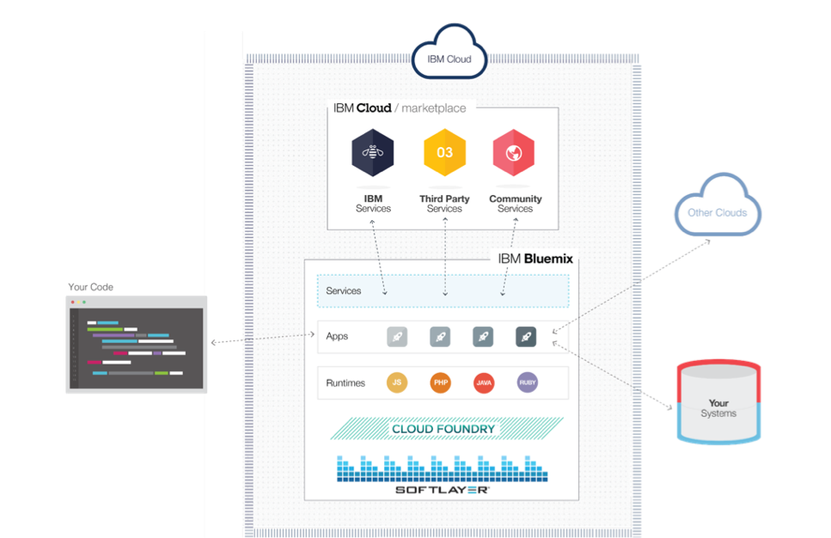
IBM Bluemix PaaS Advantages
A range of services that enable you to build and extend web and mobile apps fast.
Processing power for you to deliver app changes continuously.
Fit-for-purpose programming models and services.
Manageability of services and applications.
Optimized and elastic workloads.
Continuous availability.
Notes:
Built on the Cloud Foundry open source technology, Bluemix offers more control to application developers by using its Platform as a Service (PaaS) offering. The goal is to simplify the delivery of an application by providing services that are ready for immediate use and hosting capabilities to enable internal scale development.
With the broad set of services, runtimes and APIs in Bluemix, the developer gains control and flexibility, and has access to various data options, from predictive analytics to big data. Bluemix provides the following features:
A range of services that enable you to build and extend web and mobile apps fast.
Processing power for you to deliver app changes continuously.
Fit-for-purpose programming models and services.
Manageability of services and applications.
Optimized and elastic workloads.
Continuous availability.

Slide 7



What is Container in Cloud environment?
Virtual software objects that include all the elements that an application needs to run.
Each container includes just the application and its dependencies
Running as isolated process on the hosting operating System.
Benefits of resource isolation and allocation
Portable and efficient to help you build application fast
Notes:
A container has virtual software objects which include all the elements that an application needs to run. Each container includes just the app and its dependencies, running as an isolated process on the host operating system. Therefore, it has the benefits of resource isolation and allocation, but is more portable and efficient. Containers help you build high-quality apps, fast.

Slide 8
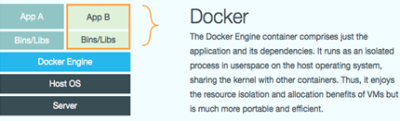
What is Docker ?
An open platform for developers and sysadmins to build, ship, and run distributed applications
Docker elements & concepts
  Docker Engine
  Docker Hub/Registry
  Dockerfile
  Image
Client-Server architecture
  Docker Service
  REST APIs
  Docker client
Notes:
Docker is an open platform for developers and sysadmins to build, ship, and run distributed applications. Consisting of Docker Engine, a portable, lightweight runtime and packaging tool, and Docker Hub, a cloud service for sharing applications and automating workflows, Docker enables apps to be quickly assembled from components and eliminates the friction between development, QA, and production environments. As a result, IT can ship faster and run the same app, unchanged, on laptops, data center VMs, and any cloud.
Images - read-only templates from which Docker containers are launched.
Registry - A service which you can push Docker images to for storage and sharing.
Public: https://index.docker.io Docker Hub
Private: build your own
Dockerfile: a text document that contains all the commands or instructions to build a Docker image for your applications.
Client-server
Docker service
REST APIs
Docker client

Slide 9
What are Docker’s Basic Concepts and Functions?
Build
Store
Run
Describes steps to build container automatically from source
Dockerfile for Container N
Container
Image Repository
Source Code Repository
Container Build Engine
Get N
Run N
Container N
…
Container A
Container B
Build N
Push new Image to Repository
Linux Container + Docker Engine
Image N
Host OS
Server
Notes:
This slide shows basic concept of components of containers in Docker and its function from Build, Store and Run stage.
Dockerfile: a text document that contains all the commands or instructions to build a Docker image for your applications.
Containers - are virtual software objects that include all the elements that an application needs to run on host.
Images - read-only templates from which Docker containers are launched. Docker image is a layer in the file system.
Container Build Engine on client side pulls the info from source code repository based on the instructions in the Dockerfile to build container image automatically. Then push the image to registry/container image repository for storage and sharing. The docker engine on the server side will get the image from repository, launch and runs the container image on the host OS. That is how it works.
Containers has layers, Layer one is init layer based on image, Layer two is actual container content to ease updates, enhance portability and fast start up.
Containers enable you to build your app in any language, with any programming tools. A container is created from an image, which is a read-only template. Containers can be run, started, stopped, moved, and deleted. Each container is an isolated and secure application platform. Apps in containers can run anywhere: development workstations that are running OS X or Windows, servers that are running Ubuntu, or production data center VMs that are running Red Hat.

Slide 10
Basic Docker Commands as an example - Build
Build Docker image
  Create Dockerfile (for WebSphere Liberty Profile)
      FROM ubuntu:12.04
      # add the files we require, jar + WLP files
      ADD wlp-developers-extended-8.5.5.2.jar /root/
      ADD wlp-developers-runtime-8.5.5.2.jar /root/
      ADD JAXWSEJBSample.jar /root/
      # install WLP
      RUN apt-get update
      RUN apt-get install -y default-jre
      RUN java -jar /root/wlp-developers-runtime-8.5.5.2.jar --acceptLicense /root/
      RUN java -jar /root/wlp-developers-extended-8.5.5.2.jar --acceptLicense /root/
      RUN cd /root/wlp && java -jar ../JAXWSEJBSample.jar /root/wlp
      EXPOSE 9080
      CMD /root/wlp/bin/server run JAXWSEJBSample
  Create a Docker image from Dockerfile by using docker build command
      # docker build -t name/wlp .
Notes:
This are some basic and commonly uses Docker commands. The example shows the steps to build and push or pull from Docker host server for WebSphere Liberty profile Docker image.

Slide 11
Basic Docker Commands as an example – Push/Pull and Run
Push /Pull Docker image
  On Docker image build server
    To tag the Docker image to a name on local or registry by docker tag command
    # docker tag name/wlp 10.0.0.1:5000/name/wlp
    To push the Docker image to registry from local system by docker push command
    # docker push 10.0.0.1:5000/name/wlp
  On Docker host to run containers
    To pull the image from repository by docker pull command
    # docker pull 10.0.0.1:5000/name/wlp
    To create and start a container in one operation by docker run command
    # docker run -p 1930:9080 -d --name test1 10.0.0.1:5000/name/wlp
Run the Docker image
  In browser, go to http://<docker-host>:1930/...
Notes:
Once the Docker image is built successfully, it can be tagged with name and store in the registry via docker tag and docker push command on the build server. You can pull the image from registry and run it on the Docker host container via docker pull and docker run commands. After deployed successfully, it is ready for access from a browser by specifying the listening port 1930.

Slide 12
IBM Bluemix Containers Advantages
deploy and manage distributed cloud workloads in a Hybrid environment
packaged as Docker containers
Docker Value | IBM Value-add | Customer Value
Docker Hub Registry holds a repository of 75000+ docker images | IBM hosted public registry containing IBM images - linked to Docker Hub Client private registry available on and off premises Curated Enterprise-ready Images | Customers have at their fingertips the images they require to deploy containers that meet their business needs and strategy
Open-source, standardized, lightweight, self sufficient LXC container technology | Enhanced performance with bare metal deployment Run images to local datacenter or cloud Deployment choice with pSeries & zSeries | Hybrid Cloud choice and flexibility to choose the right mix for their business
Build, ship, and run standardized containers | Integrated monitoring & logging Elasticity to grow storage & container needs life-cycle management of containers and data volumes | Docker simplicity and ease of use with the Enterprise-level of integrity and confidence to run a business
Container connections using links and service discovery | Private network communication External IP address | Extends and connects Docker containers to production-ready Enterprise environments
+
=
+
=
+
=
+
=
Notes:
IBM Bluemix provides the Docker based Containers infrastructure with enhanced features to deploy and manage distributed cloud workload in a hybrid environment and packaged as Docker containers for delivery of additional value to customer. The IBM Containers engine's lightweight run time enables rapid scale-up and scale-down in response to changes in demand. On Bluemix, you start developing with containers by using a trusted container image. With your org's private registry, you can automate your build pipeline and share artifacts with collaborators through public or private registries. Containers simplify system administration by providing standardized environments for development and production teams. They help remove the complexity of managing different operating system platforms and underlying infrastructure. Containers help you deploy and run any app on any infrastructure, quickly and reliably.

Slide 13
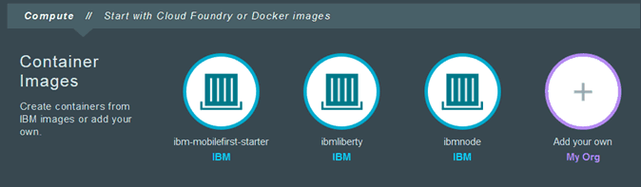
IBM Bluemix Container Advantages & Differentiators
5 Key Differentiators:
Push and pull containers from on-premises to off-premises service
Hosted private registry with access controls
Integrated container monitoring and logging
One-step public IP configuration
Services integration, including seamless infrastructure as a service and platform as a service with other Bluemix services such as analytics
Key Advantages:
Automate the build of Docker images
Manage and distribute Docker images in private Docker registries
Easily host container in the cloud
Scale and auto-recovery built-in
Logging and monitoring built-in
Notes:
There are 5 key differentiators Bluemix Container provides: http://thoughtsoncloud.com/2015/02/5-game-changing-capabilities-from-ibm-containers-on-bluemix/
You have the ability to download and run containers on-premises (through a local workstation or private cloud) for use prior to running in the public cloud. Using the IBM Container Extensions (ICE) command line, you can easily automate the deployment of containers to a private or public cloud.
With security and privacy as top concerns, you don’t want to store your containers in publicly accessible registry hubs. The IBM Container offering on Bluemix allows you to store your images on the cloud with the controls to ensure no one else can access them.
As soon as you deploy new containers, you gain insight into the CPU, memory and network utilization per container, as well as access to the latest log messages.
It could not be easier to request a publicly accessible IP address and assign it to a container using ICE commands. After fully testing the app in your container, you can bind a public IP to it and run the app on the Internet.
IBM Bluemix allows you to bind any Bluemix app to an existing container, enabling you to run your newly created PHP app on a container.

Slide 14
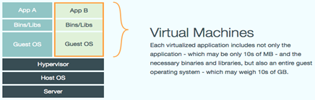
What is an Openstack Virtual Machine?
A software implementation of a machine hosted by a real machine based on Openstack
Includes the application, its dependencies/middlewares and a guest OS
Managed by a hypervisor server for resources allocation and provisioning
Multiple VMs can run simultaneously on a single host
Guest OSs might not be the same as the host OS
Notes:
A virtual machine is a software implementation of a machine that executes programs like a real machine. Within the virtual machine (VM) is the application and a complete operating system, running on virtualized hardware that is provided by a hypervisor. The hypervisor separates the virtual machine from the host, and allocates resources as needed. Many VMs can run simultaneously on a single host system. The guest OS might not be the same as the server of host OS.

Slide 15
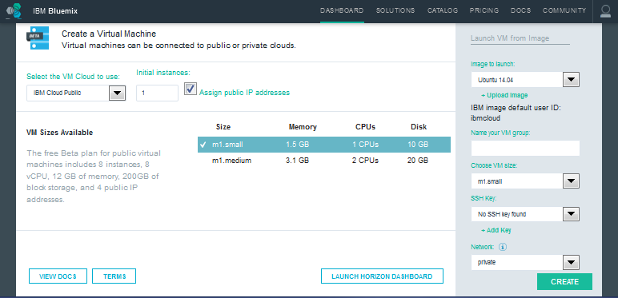
IBM Openstack VM’s Advantages
Bluemix VMs infrastructure as beta feature in select regions
Enable creation of VMs running in public and private Openstack clouds
Allow reuse of existing VM images
Provision VM groups with auto scaling and load balancing against a target cloud
Manage operations via dashboard or CLI/API
View VM info, such as instance ID, IP, CPU, Memory, Disk resources and status of VM
Supports OpenStack project deployments, and scales both horizontally and vertically
Notes:
IBM Bluemix provides the virtual machines infrastructure as a beta feature that is available in select regions. This infrastructure enables you to create virtual machines that are running in public and private (on-premises) OpenStack clouds. For the private, on-prem cloud, you must first connect it to Bluemix so that it's available to use with your virtual machine.
With virtual machines in Bluemix, you can create virtual machine group instances for public and private clouds by using images from existing VM images. You can provision VM groups with auto scaling and load balancing against a target cloud. You can view detailed information of each virtual machine instance in the virtual machine group that you create. Details include instance ID, IP addresses, number of CPUs, total memory, disk size, and the status. You can stop, pause, or delete instances. You can also perform advanced operations from the provided OpenStack Horizon Dashboard or from OpenStack CLI/APIs.

Slide 16
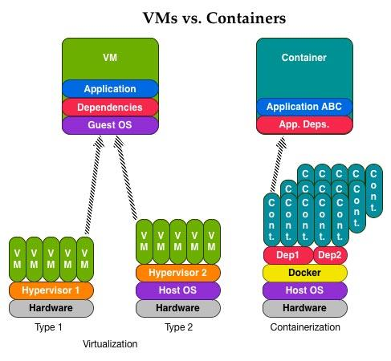
Deploying to the Cloud in a repeatable way
Standardization and choice for delivering the best business value for you
Containers & VMs
Understanding both technologies
Container Approach
Build:
  Software stack can be individually packaged
Deploy:
Software stack in a Docker container can be easily moved between deployment environments
Change:
  Recomposed software into new stacks
Value:
Built-on-the-cloud applications
Loosely coupled, elastic architectures
Virtualization Approach
  Build
  Package the (guest) operating system
  Add required files and programs
  Deploy:
  This entire “package” can be moved and reconfigured across different physical machine
  Change:
  Change details of the software within the virtual machine and then create a new virtual machine.
  Value:
  Traditional cloud-enabled workloads
Notes:
This charts shows the differences between Containers and VMs approaches from build, deploy, update of application life cycle and value perspectives.
We like to deploy applications to the cloud in a repeatable way via standardization and make choice that could deliver the best business to you.
Currently both Containers and VMs are in beta and available on Bluemix for your to explore. Containers will be GA soon.
We will explore more detail on Cloud Foundry approach in next section – Section 2.

Slide 17















Timing is Critical …so are all of your other investments
Leverage the power of Bluemix without abandoning what you already use.
Core IT
IaaS
PaaS
IBM Bluemix
Notes:
While timing is critical (what we just discussed), the systems and data you use today can’t be forgotten. That’s why Bluemix simply and securely connects to core IT and even other clouds (leveraging IBM’s proven reputation as a systems integrator).
Hybrid cloud, where Public and Private clouds work together with Core IT investments, is critical to success given the app revolution and the expectations and increased competition it has generated.
Overall, hybrid cloud represents the “New IT…”

Slide 18
Bookmarks & References
http://www.ibm.com/cloud-computing/us/en/
http://www.ibm.com/cloud-computing/us/en/iaas.html
http://www.ibm.com/cloud-computing/us/en/paas.html
http://www.ibm.com/cloud-computing/us/en/saas.html
http://www.ibm.com/developerworks/cloud/library/cl-open-architecture/
http://www.ibm.com/cloud-computing/us/en/open-cloud-essentials.html
https://www.bluemix.net
https://www.ng.bluemix.net/docs/#starters/index-gentopic4.html#genTopProcId5
https://www.ng.bluemix.net/docs/#starters/index-gentopic3.html#container_ov
https://www.docker.com/
https://www.clouddoundry.org/
Notes:
Here’s a list of useful bookmarks on the topics we covered in this section for your reference.

Slide 19
QUESTIONS?
https://ibm.biz/BdXGBL
Get help from Bluemix development team and Stack Overflow community
Notes:
Please post your questions or find the answers on Bluemix Community https://ibm.biz/BdXGBL

